Slide 1
Create and modify Data Tables and Pivot Tables

Slide 2
Creating Data Table
Select a cell within your data.
Select Data> What if Analysis> Data Table
In the Create Table dialog box, set your cell range.
Select OK.

Slide 3
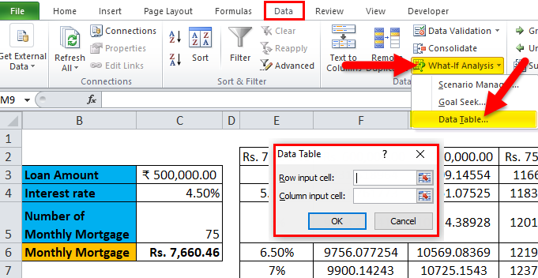
Creating Data Table(Cntd...)

Slide 4
Adding rows and columns adjacent to table
Click in a blank cell next to the table.
Type a cell value.
Click anywhere outside the cell or press the Enter key to add the value.

Slide 5
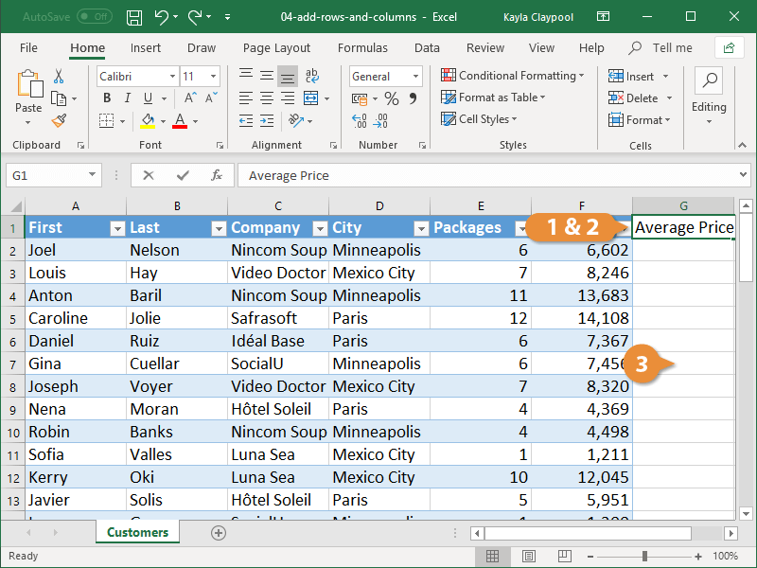
Adding rows and columns adjacent to table(Cntd…)

Slide 6
Insert a Row or Column within a Table
Select a cell in the table row or column next to where you want to add the row or column.
Click the Insert list arrow on the Home tab.
Select an insert table option.
Insert Table Rows Above: Inserts a new row above the select cell.
Insert Table Columns to the Left: Inserts a new column to the left of the selected cell.

Slide 7
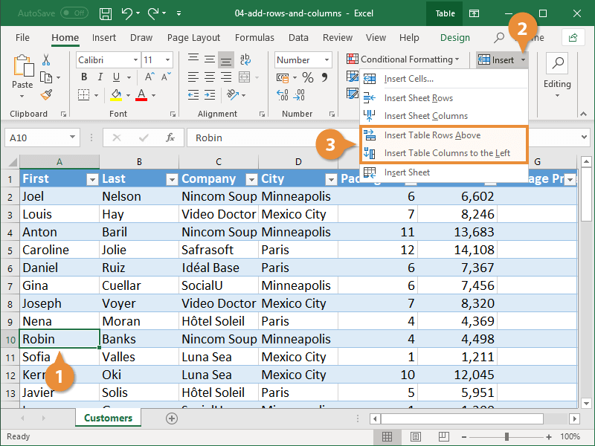
Insert a Row or Column within a Table (Cntd…)

Slide 8
Delete Rows and Columns
Select a cell in the row or column you want to delete.
Click the Delete list arrow.
Select Delete Table Rows or Delete Table Columns.

Slide 9
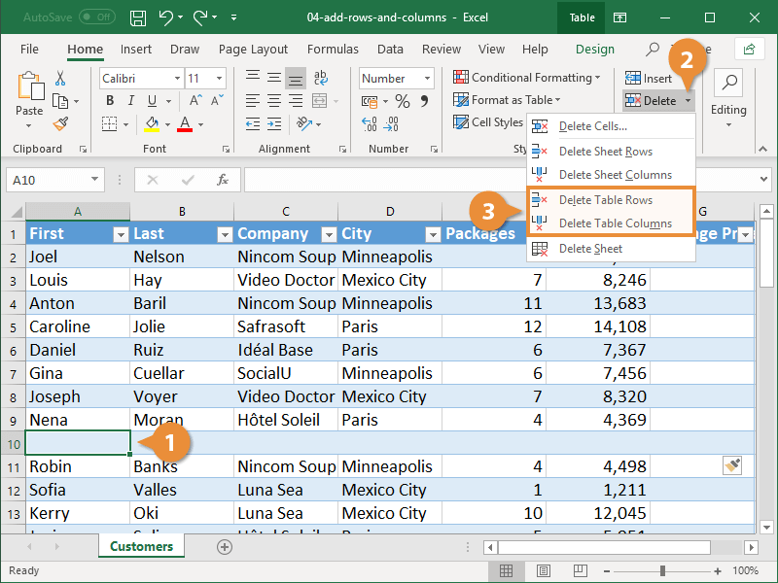
Delete Rows and Columns(Cntd…)

Slide 10
Create pivot table
Select the cells you want to create a PivotTable from.
Select Insert > PivotTable.
This will create a PivotTable based on an existing table or range.
This will create a PivotTable based on an existing table or range.
Choose where you want the PivotTable report to be placed.
Click OK.

Slide 11
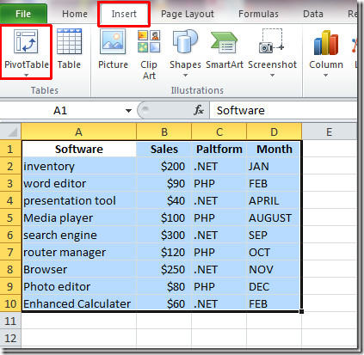
Create pivot table(Cntd…)

Slide 12
Change the PivotTable Data Source
Click PivotTable Tools | Analyze tab.
In Data group, click the Change Data Source button.
The invoked dialog allows you to select the new source range for the pivot table.

Slide 13
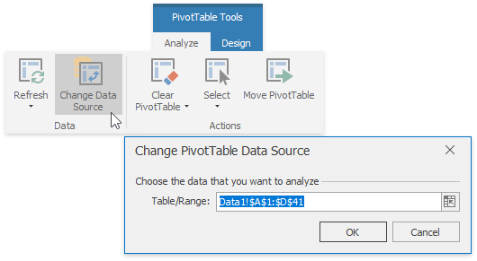
Change the PivotTable Data Source(Cntd…)

Slide 14
Move the PivotTable
On the PivotTable Tools | Analyze tab.
In the Actions group, click the Move PivotTable button.
The invoked dialog allows you to move the report to another cell range within the existing worksheet or to a new worksheet.

Slide 15
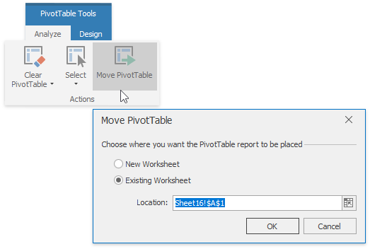
Move the PivotTable(Cntd…)

Slide 16
Tasks
Create a data table, insert some data into it & save it.
Add columns and rows both externally.
Add columns and rows both internally.
Create a pivot table, insert some data into it & save it.
Change the pivot table data source.
Move pivot table to another location.

Slide 17
THANKS

